Slide 1
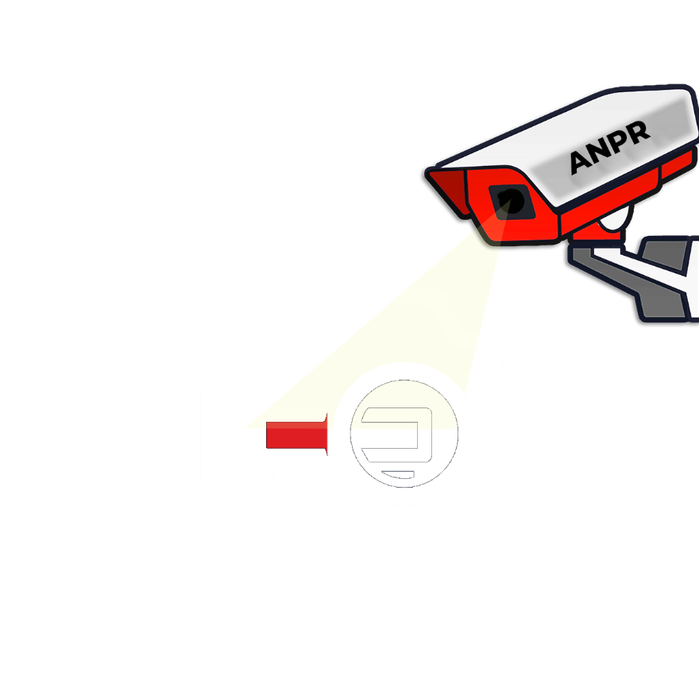
Real time Bangladeshi License Plate Detection & Recognition
1
Supervised by:
Qamrun Nahar Eity
Assistant Professor, CSE
Ahsanullah Univeristy of Science and Technology
Submitted by:
MD. Saimom Islam 160204011
Tauhidul Islam 160204031
MD. Yeasir Arafat 160204093
Homaira Alam 160204102

Slide 2
Introduction
2
What is ANPR
ANPR
Fixed ANPR
Mobile ANPR
3 major steps of ANPR
Detection
Segmentation
Recognition

Slide 3
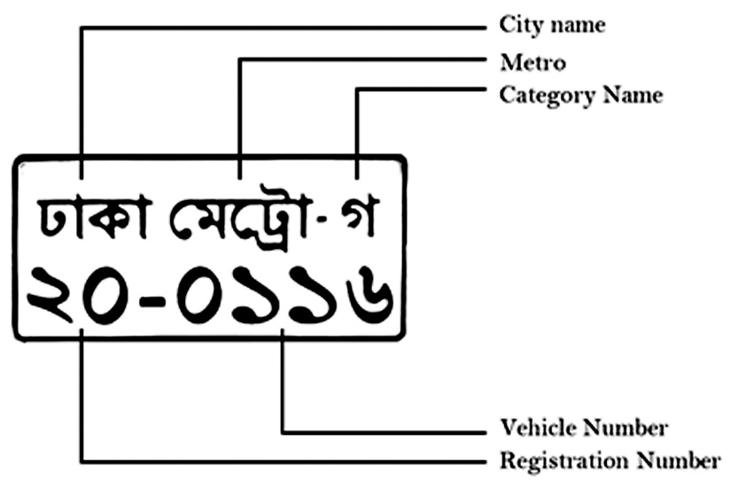
Study of Bangla License Plate
3

Slide 4
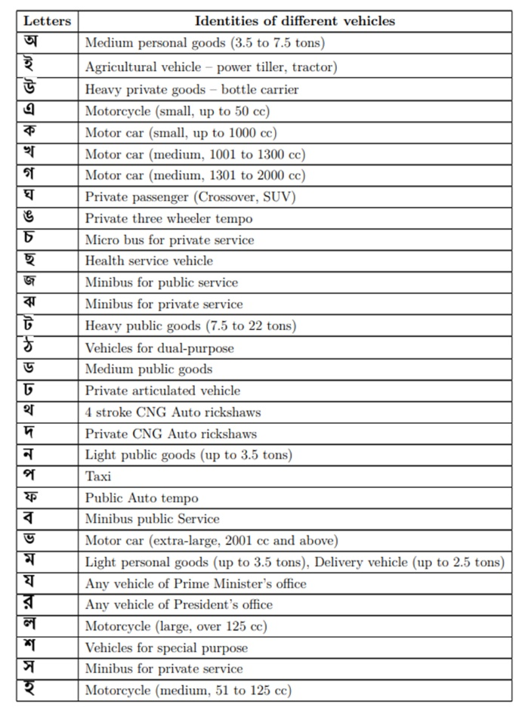
Letters and the identities of different vehicles
4

Slide 5
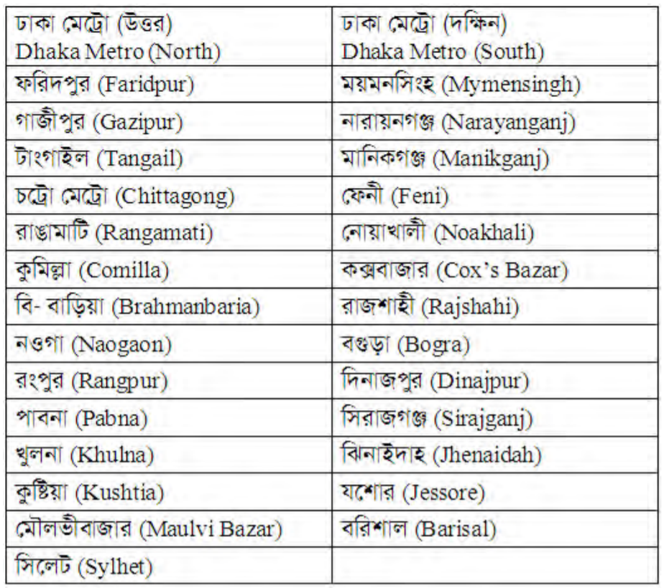
29 Vehicle Registration Areas
5

Slide 6
Motivation
6
Identifying stolen vehicle
Toll collection
Traffic management
Parking management
Added Security
Easy and Efficient
Cost Effective
Stand Alone
Provides Evidence
Congestion Control

Slide 7
Literature Review
7
Paper | Data Set | Methods | Accuracy
1 | Used own dataset | R-CNN model for Image segmentation | • Recognition accuracy for challenging normal is 45% • Recognition accuracy for ip-skewed is 86% • Recognition accuracy for vp-skewed is 25%
2 | Used own dataset | • YOLOv3 for Number Plate Detection • ResNet-20-based CNN network with this dataset to recognize the single character • Bounding Box Coordinate provided by YOLOv3 for segmentation | • 85% accuracy for number plate detection • 92.7% accuracy for character recognition
3 | Used own dataset | YOLOv3 model based CNN for Number Plate Detection, Segmentation, Character Recognition | The accuracy is around 97% for number plate detection.
4 | Did not need dataset | Bounding Box on filtered Binary Image for Segmentation of characters and words | Did not learn anything. They Segmented and recognition by hard coding. Maximum Number plate’s Number and character can be segmented properly

Slide 8
Literature Review
8
Paper | Data Set | Methods | Accuracy
5 | Used own dataset | Faster R-CNN to detect the Number Plate | 91.6% accuracy for number plate detection
6 | Used own dataset | CNN Model to detect the Number plate and character recognition | Highest accuracy is 88.7%
7 | Used own dataset | • Morphological Transformation for gray scale image • Gaussian blur is used to remove noise for segmentation • Bounding box for character extraction • Deep learning architecture is used for recognition | • 93% accuracy for number plate detection • 98% accuracy for character segmentation • 98% accuracy for recognition
8 | Used own dataset | MATLAB functions are used | 80% accuracy
9 | Did not need dataset | • MATLAB functions are used to detect number plate • MATLAB functions are used for character recognition | 90% accuracy for close range

Slide 9
Literature Review
9
Paper | Data Set | Methods | Accuracy
10 | Did not need dataset | • HAAR Feature based Classifier to detect license plate • Class letter extractor with a proposed method • Convolution Neural Network for recognizing class letters | • 96.92% accuracy for number plate detection • 94.61% accuracy for class letter segmentation • 90.90% accuracy for recognition rate with real-time performance
11 | Used own dataset | • Square tracing algorithm for finding number plate bounding contour • Rotation matrix for skewness • horizontal and vertical projections with threshold to segment Bangla characters and digits efficiently | • Average detection rate of their algorithm is 93% • Segmentation rate 98.1% • Recognition rate 88.8%
12 | Did not need dataset | • HSI color model • Geometrical properties • Candidate Regions • Intensity Histogram | The rate of success of the license plate detection algorithm is 85%.
13 | Used own dataset | Tesseract OCR machine on processed image for License plate detection | The final result was found to be very near to the actual value on the plates.

Slide 10
Literature Review
10
Paper | Data Set | Methods | Accuracy
14 | Used own dataset | • Sobel’s mask operator • Otsu’s thresholding method • Connected Component Analysis • Feature extraction | • License plate detection accuracy 95% • Character segmentation accuracy 99% • License plate recognition accuracy 91%
15 | Used own dataset | • Sobel filters • Local adaptive thresholding • Hough Transform • Contour algorithm • OCR module • HMM (Hidden Markov Model) | • License plate detection accuracy 98.76 for both image set% • Character segmentation accuracy 97.61 for both image set% • OCR module accuracy 97.52 for both image set% • Whole system accuracy 92.85%
16 | Used own dataset | Faster R-CNN | Not mentioned
17 | Used own dataset | YOLO based network | • Segmentation 99% • Recognition 93%
18 | Used own dataset | Histogram based approach, Optical character recognition (OCR) | Not mentioned

Slide 11
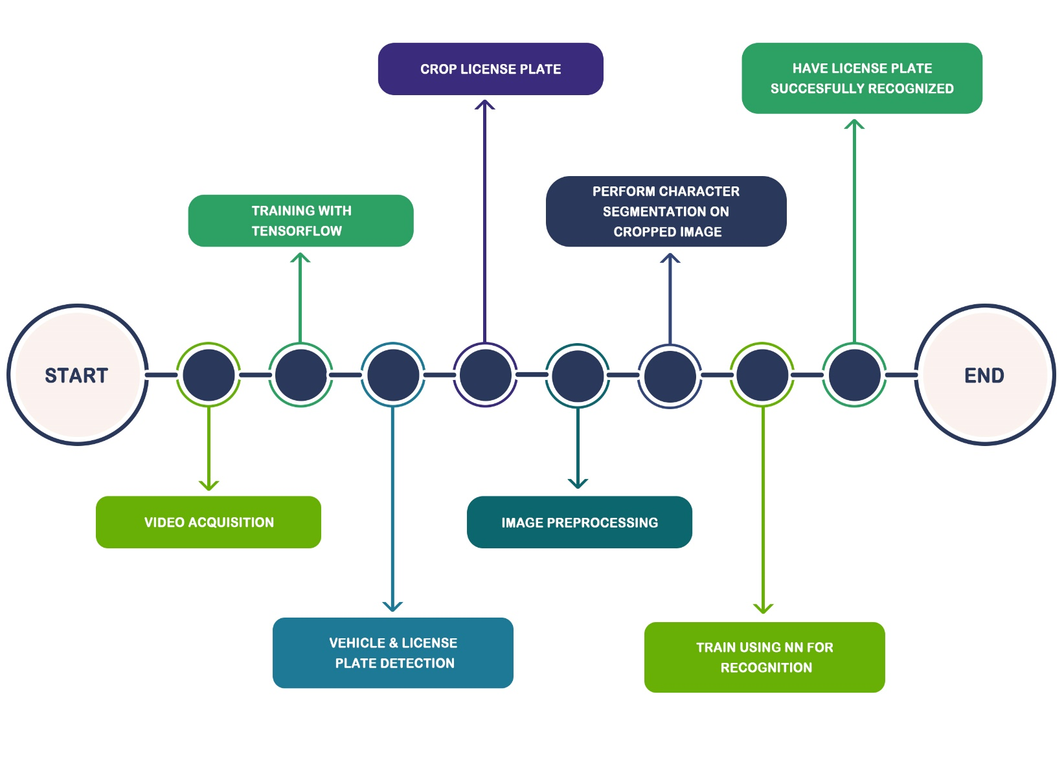
Methodology
11
Proposed Work Flow

Slide 12
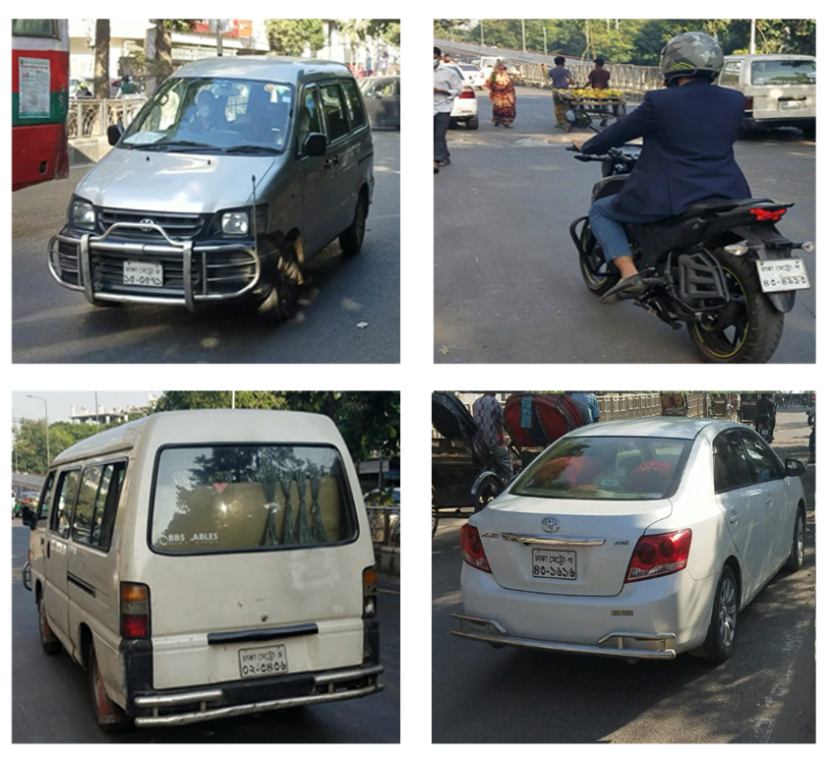
Video Acquisition
12

Slide 13
Training with TensorFlow
13
Labeling
.xml to .csv file
Change .config file of the model
Save as .xml
.csv to tfrecord
Train

Slide 14
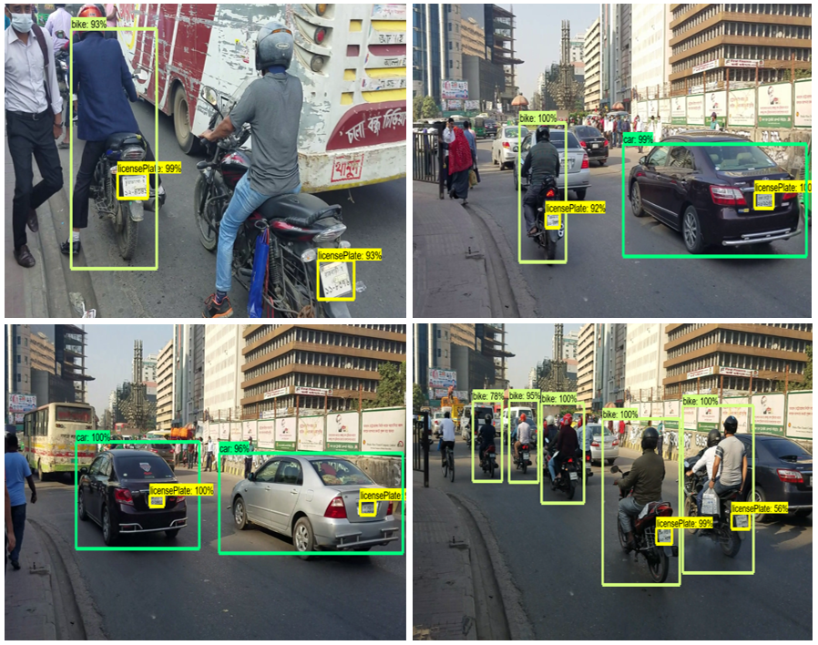
Vehicle and License Plate Detection
14

Slide 15
Models Used to Train for Detection
15
Faster R-CNN
SSD (Single Shot Multibox Detector) Mobilenet V1 COCO
SSD (Single Shot Multibox Detector) Mobilenet V1 FPN COCO
SSDlite Mobilenet V2 COCO

Slide 16
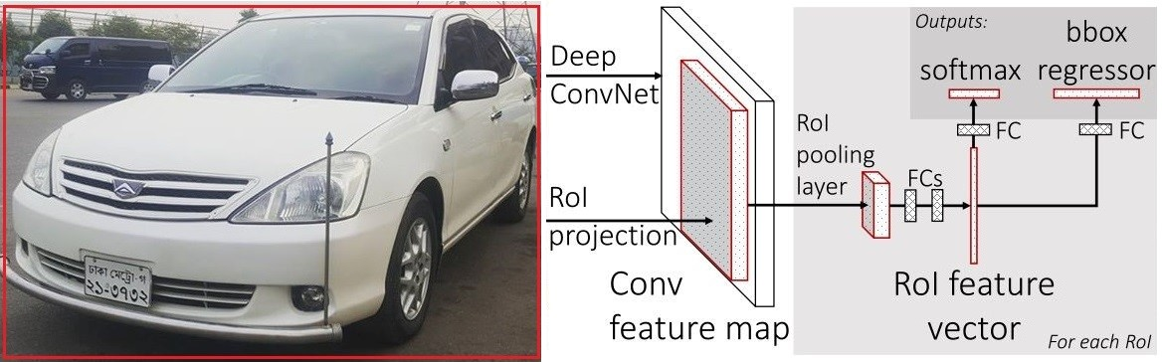
Models Used to Train for Detection
16
Faster R-CNN

Slide 17
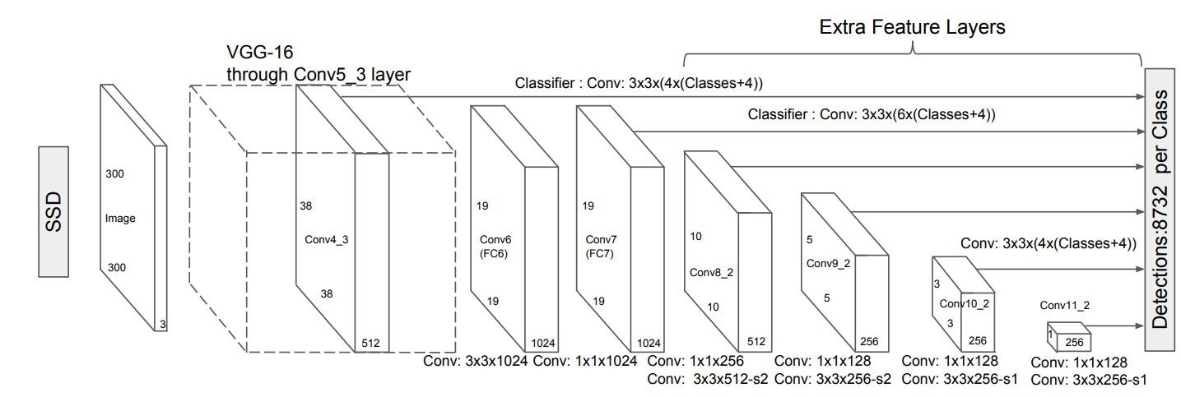
Models Used to Train for Detection
17
SSD (Single Shot Multibox Detector) Mobilenet V1 COCO

Slide 18
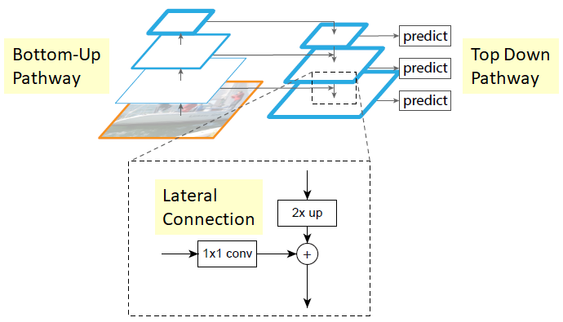
Models Used to Train for Detection
18
SSD (Single Shot Multibox Detector) Mobilenet V1 FPN COCO

Slide 19
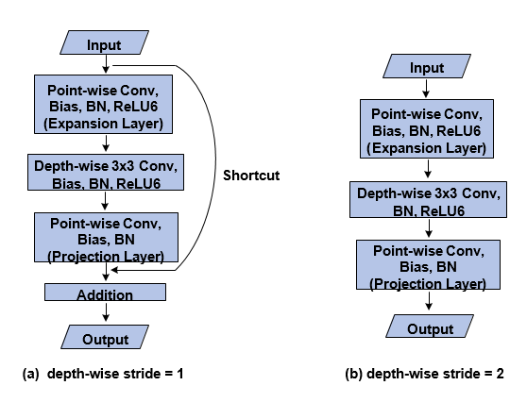
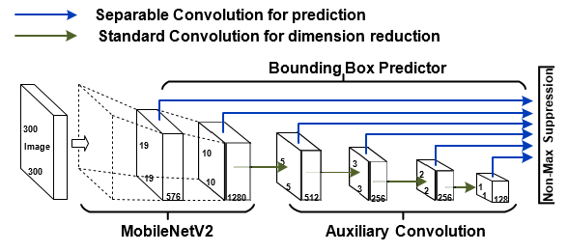
Models Used to Train for Detection
19
SSDlite Mobilenet V2 COCO

Slide 20
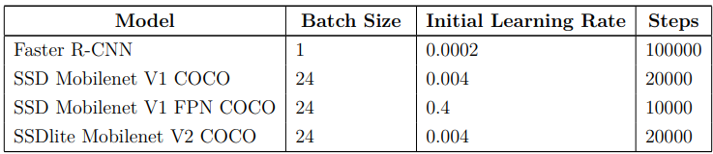
Models Used to Train for Detection
20
Training parameters

Slide 21
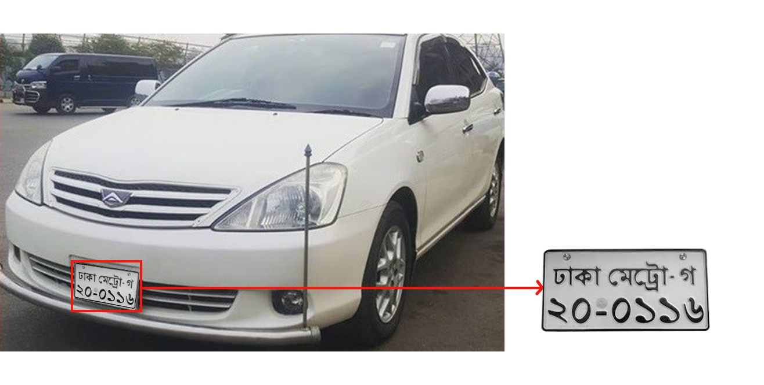
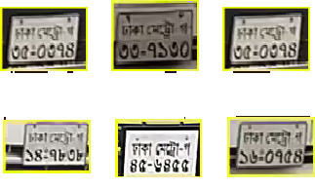
License Plate Cropping
21
Examples of few of our cropped license plates

Slide 22
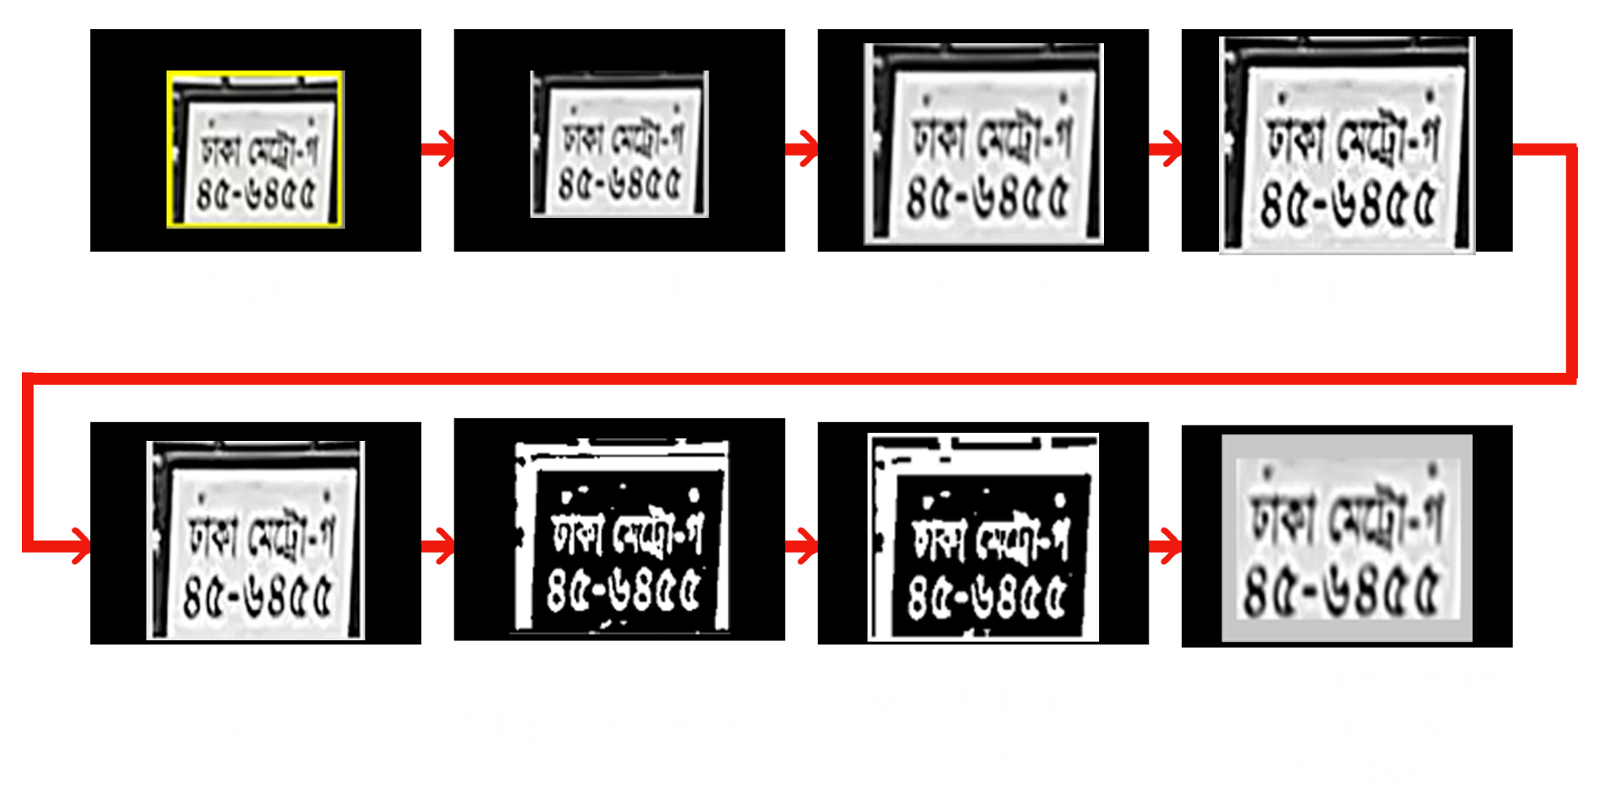
Image Pre-processing
22

Slide 23
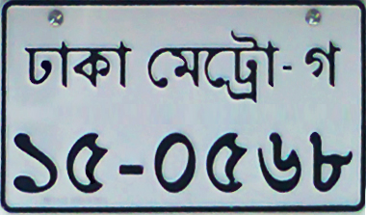
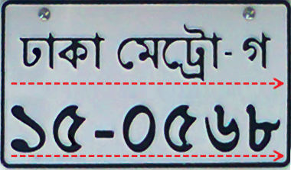
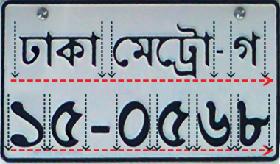
Character Segmentation
23
Separating the rows (Horizontal Segmentation)
Separating the characters and digits (Vertical Segmentation)

Slide 24
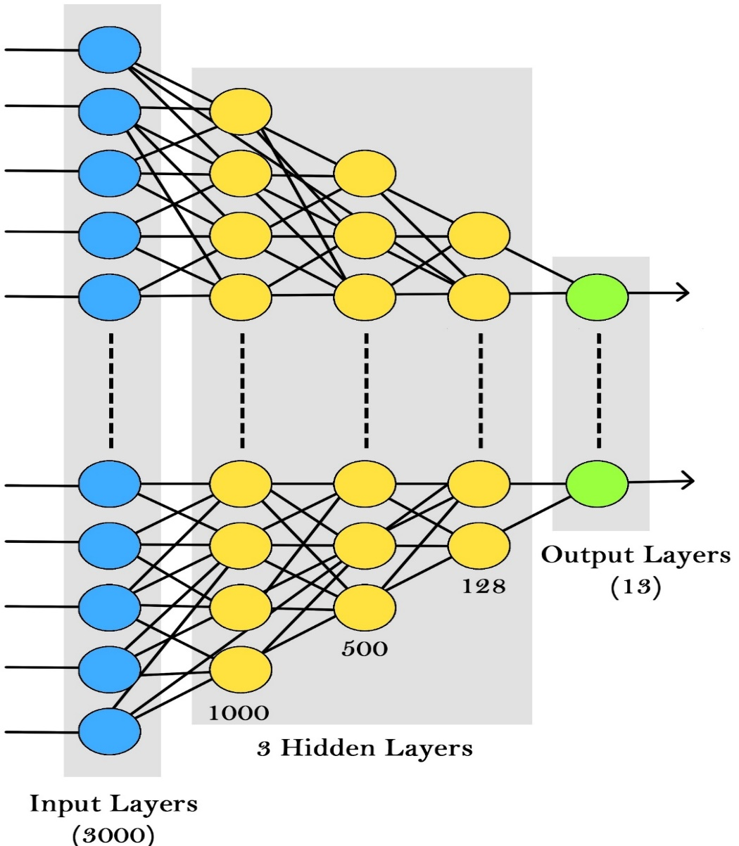
Train System using NN for Recognition
24

Slide 25
Train System using NN for Recognition
25
Hyper Parameters
Batch Size = 50
Number of Iterations = 10000
Input Dimension = 100*30
Number Features = 3000
Output Dimension = 13
Learning Rate = 0.01
Hidden layer = 3

Slide 26
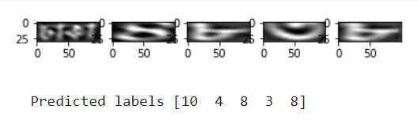
Train System using NN for Recognition
26
Predicted labels using Neural Network

Slide 27
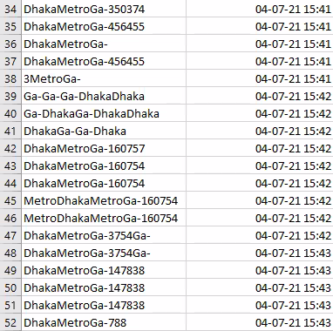
Saved Number Plates in CSV File
27

Slide 28
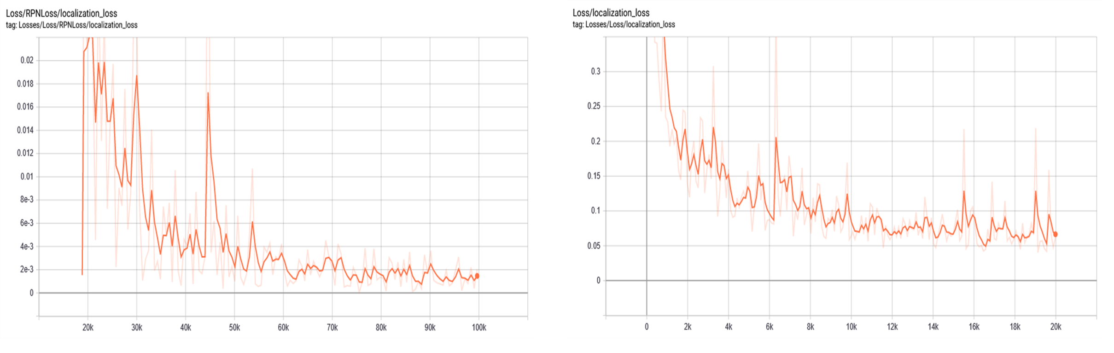
Experimental Result
28
Loss graph of SSD Mobilenet V1 COCO

Slide 29
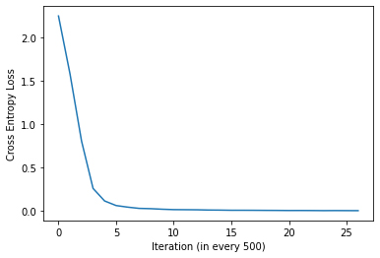
Experimental Result
29
Loss Graph Of Recognition

Slide 30
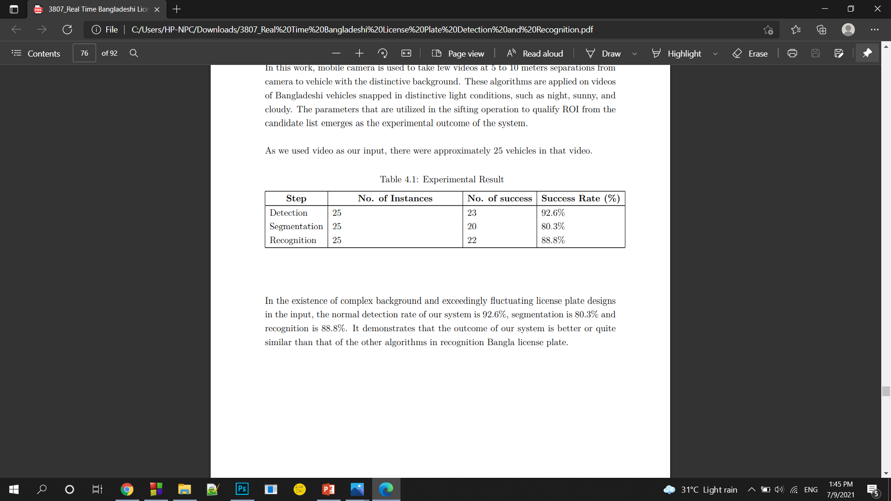
Experimental Result
30
Accuracy for Each Steps

Slide 31
Difficulties we have faced
31
Image and video collection
Not being able to collect diverse dataset
Problem faced during segmentation
Manually finding a range for contours

Slide 32
Limitations
32
Video frame rate should be 25 fps or less
Video resolution should be 720 px
As we only had one camera, some vehicles and license plate images were missed
Only the vehicles with registration area Dhaka Metro found
Some license plates are too old and blurry
Without enough lighting, system cannot recognize license plate

Slide 33
Future Works
33
Automatic toll collection system
Stolen vehicle identification
Parking management
Can be implemented using high resolution camera
Make distinctive kinds of formats for different specifications
Few limitations like skew in the picture etc. can be expelled

Slide 34
34
Conclusion

Slide 35

35

